Slide 1
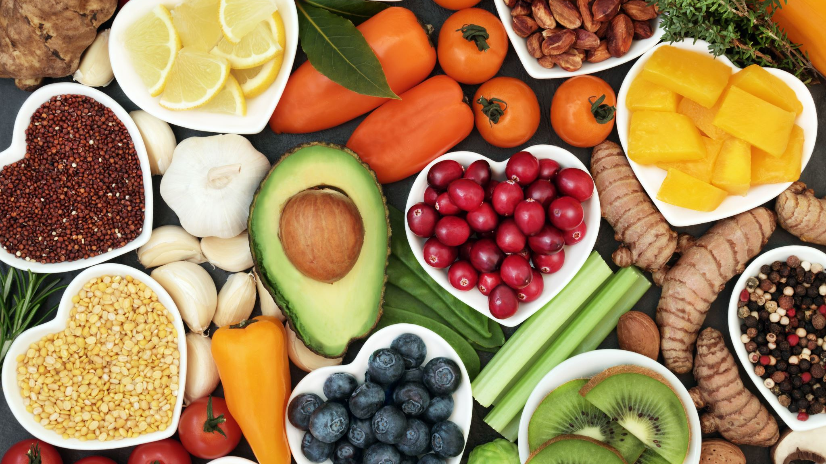
Calorie Counter
By:
Faygie Fruchthandler
Etty Tepper
Aliza Peikes
Aliza Fried

Slide 2
OUR VISION: To create a quick and user-friendly way for people to track their daily calorie intake. Science has proven that all humans need calories, or energy, to operate. However, when we consume more calories than we need, those calories get converted to fat. With our application, users can easily see how many calories they’ve eaten that day and how many more they can still consume. Through this, we help the users ensure that they don’t go over their daily calorie allowance.

Slide 3
User’s journey
Enter personal information
1
Choose a diet plan
2
Track calorie intake
3
Create a list of favorite foods
4

Slide 4

Personal Information User inputs basic information:
Name
age
Height
Weight
gender
standard exercise

Slide 5
Personal Information
Based on the users input, we calculate BMR and BMI
BMR – Basal Metabolic Rate – rate at which your body burns calories through involuntary activities.
Formula is based on Height, Weight, and Gender
Male: BMR = 66 + (6.23 * weight) + (12.7 * height) - (6.8 * age)
Female: MR = 665 + (4.35 * weight) + (4.7 * height) - (4.7 * age)
We used BMR to determine the amount of calories a person needs to maintain their daily activities.

Slide 6
Personal Information
Based on the users input, we calculate BMR and BMI
BMI – Body Mass Index – It is derived from body mass and height of a person and it determines whether a person is at a healthy weight.
Formula is based on height and weight
BMI= weight (lb) / [height (in)]² x 703
Together with BMR and exercise, we used BMI to evaluate a recommended diet plan.

Slide 7
Chose a Diet Plan

Slide 8
Choose a Diet Plan
User is given an a recommended diet and has a choice to stay with it or not.
Weight Gain
Maintenance
Weight Loss
Extreme Weight Loss

Slide 9
Track Calorie Intake
Add Calorie Intake
Check Calorie Count

Slide 10
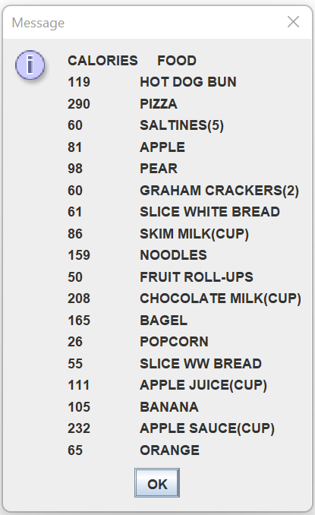
Track Calorie Intake
Add Calories:
Numerical calorie amount
Name of a food from a list of staples
User has the option to add a commonly eaten food to the list

Slide 11
Track Calorie Intake
Check Calorie amount

Slide 12

Feedback
Thank you for listening
We would love to hear your feedback at:
feedback@caloriecounter.com

